Slide 1
AJAY KUMAR GARG ENGINEERING COLLEGE 27TH KM STONE DELHI-HAPUR BYPASS ROAD ,P.O ADHYATMIK NAGAR GHAZIABAD-201009
INTERNSHIP TRAINING PROJECT
ON
DATA ANALYTICS USING PYTHON
AT
ANTRIX ACADEMY,NOIDA
SUBMITTED BY:
NANCY SINGH (1900270100113)
3rd YEAR
5th Semester
CSE - 2

Slide 2
PROJECT NAME:
Olympics Data Analysis Using Python

Slide 3
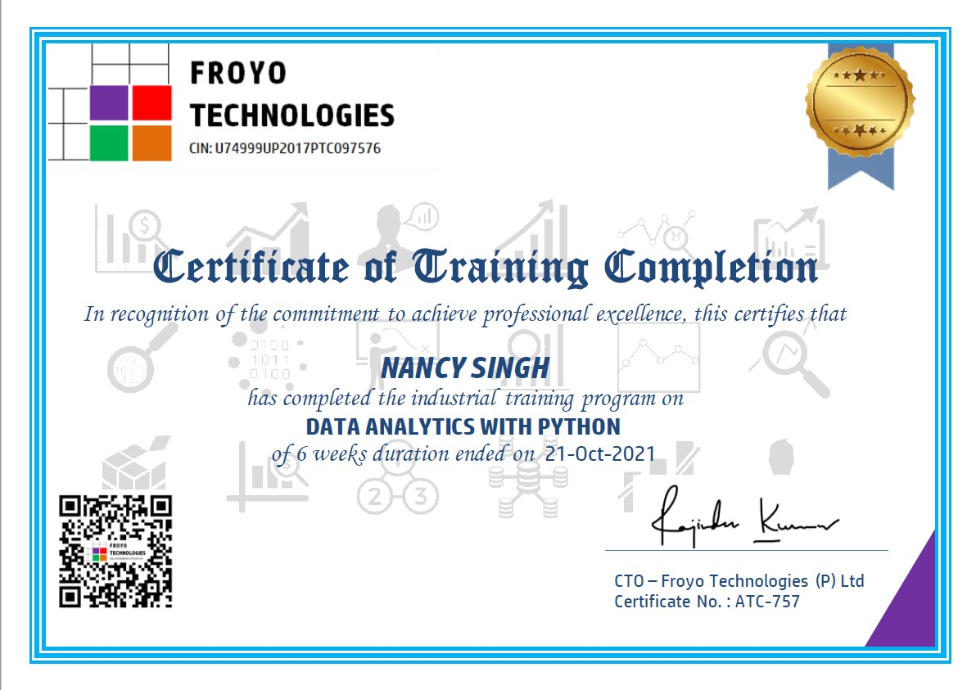
CERTIFICATE OF COMPLETION

Slide 4
ABSTRACT
This program has been developed by industry experts to help you learn real-world application of Data Science from scratch and build powerful models to generate useful business insights and predictions. This program has been designed for fresh graduates looking to build their career in Python and Machine Learning in their future.
At The End Of This Course You Will:-
Able to analyse data sets , create various insights on the same.

Slide 5
WHAT IS DATA & Data Science??
Data basically refers to facts and statistics collected together for reference or analysis.
Data Science is process of extracting knowledge & insights from data by using scientific methods.
Scientific Methods refers to Programming + Statistics + Buisness.

Slide 6
WHAT IS DATA ANALYSIS and its advantages??
Data Analysis is the process of exploring and analyzing large datasets to find hidden patterns, unseen trends, discover correlations & valuable insights.
Data Analytics and Visualizations can be used for Improved Decision Making, Better Customer Service, Efficient Operations as well as Effective Marketing.

Slide 7
TYPES OF DATA THAT COMPANY COLLECTS??
First – Party Data: The data that is directly collected by the company from its own costumers.
Second – Party Data : The data that a company collects from the other known organizations which collected the data themselves.
Third – Party Data : The aggregated data that a company buys from a marketplace.

Slide 8
Steps involved in data analytics process
Understand the problem : Before you start collection of data , you must be clear about what exactly you want to do with it..
Data Collection : After knowing what you want from the data it is the time for collecting data.
Data Cleaning : It consist of amending or removing incorrect data, as well as checking for incompleteness or inconsistencies.
Data Exploration and Analysis : In this step, you’ll begin to slice and dice your data to extract meaningful insights from it. Using the techniques and methods of data analysis, you’ll look for hidden patterns and relationships, and find insights and predictions.
Interpret the results :create visualizations by selecting the most appropriate charts and graphs.

Slide 9
Objective of the project
We need to perform exploratory Data Analysis using Python to analyse and visualize past Olympics Data and answer specific questions.

Slide 10
Software & HArdWARE REQUIREMENTS
HARDWARE REQUIREMENTS :
Intel CORE i5 10th GEN
Personal Computer 8GB RAM
SOFTWARE REQUIREMENTS :
Jupyter Notebook
Brave
Microsoft Power Point for Presentation

Slide 11
OLYMPICS GAMES
The Olympic Games is a well-known sporting platform which is recognized all over the world, has been distinguished from the late 19th century.
It first began in 1896 – Athens,Greece.
Currently, it is held every 2 years in different countries, with names as Summer Olympics and Winter Olympics , both having their own set of games.
The 5 rings in the logo represents the five continents: Europe, Africa, Asia, The Americas and Oceania.

Slide 12
DATA SETS USED IN THE PROJECT
DATASET 1 : athlete_events.csv file
DATASET 2 : noc_region.csv file
We have downloaded the above two data sets from the website Kaggle.com

Slide 13
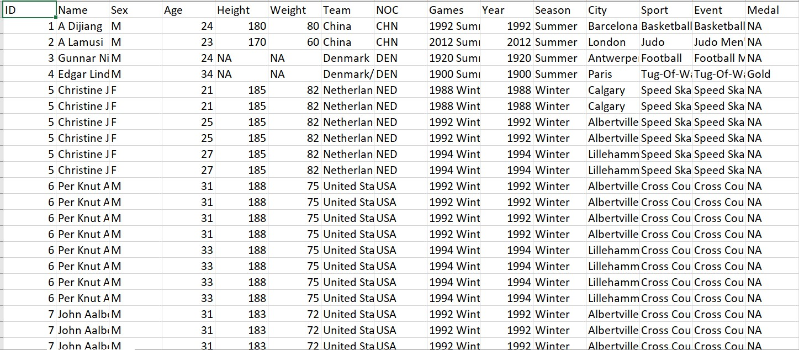
DATASET 1: athlete_events.csv file

Slide 14
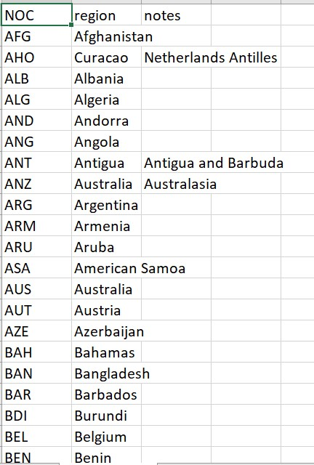
Dataset 2: noc_region.csv file

Slide 15
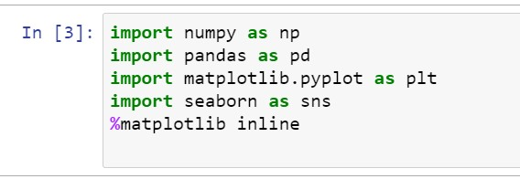
Libraries used

Slide 16
Libraries used cont.
NumPy : NumPy is a general-purpose array- processing package
Provides efficient storage
It is fast
It is easy to learn
It also provides better ways of handling data for processing
NumPy relatively uses less memory to store data

Slide 17
Libraries used cont.
Pandas : It is an open source library built on top of the NumPy library.
It is popular for importing and analyzing data much easier.
Pandas is fast.
Pandas provides high-performance and high productivity for its users.

Slide 18
Libraries used cont.
Matplotlib : It is built on NumPy arrays.
It consists of several plots like line , bar , scatter , histogram , etc.
Pyplot is a matplotlib module which provides MATLAB like interference.

Slide 19
Libraries used cont.
Seaborn : It is mostly used for statistical plotting in python.
It is built on top of Matplotlib.
It provides default styles and color palettes to make statistical plots more attractive.

Slide 20
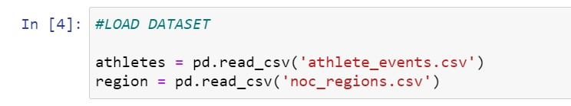
Task 1: LOADING THE DATASET

Slide 21
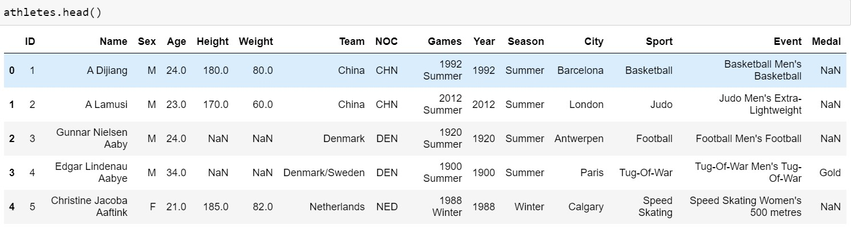
Task 2: Printing the loaded datasets

Slide 22
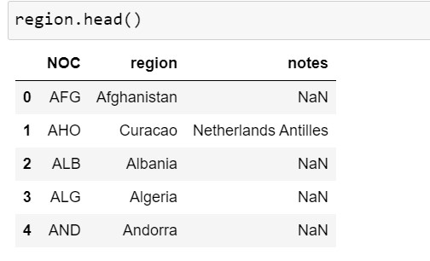
Task 2 Cont.

Slide 23
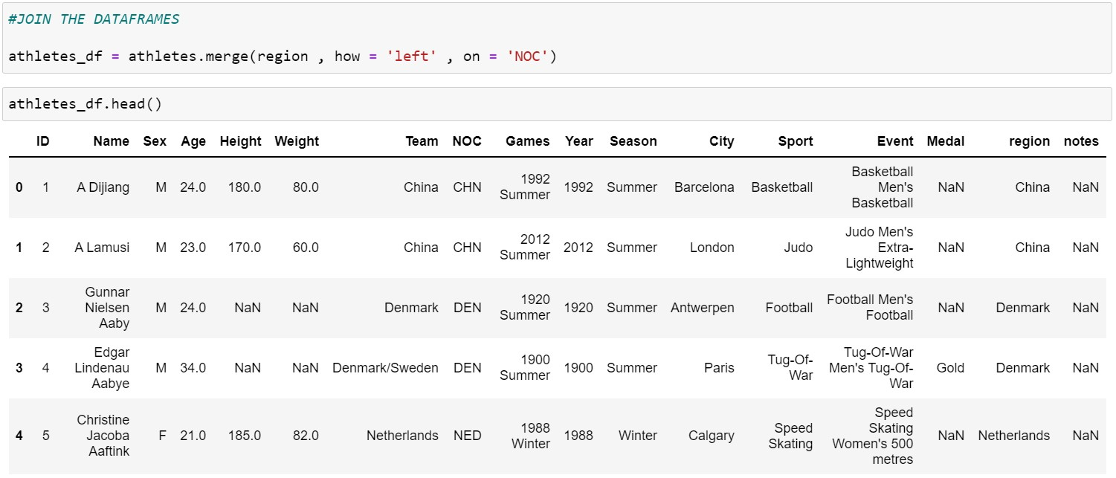
Task 3: join both datasets and print them

Slide 24
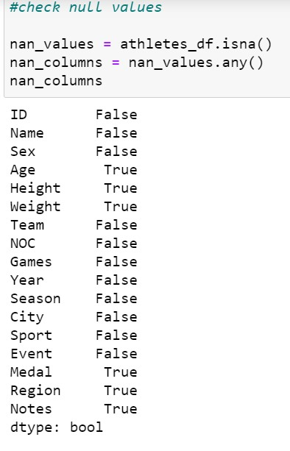
Task 4: Check for the null values in the dataset

Slide 25
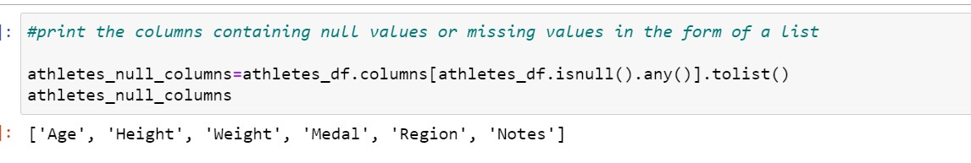
Task 5: print columns containing null values in form of a list

Slide 26
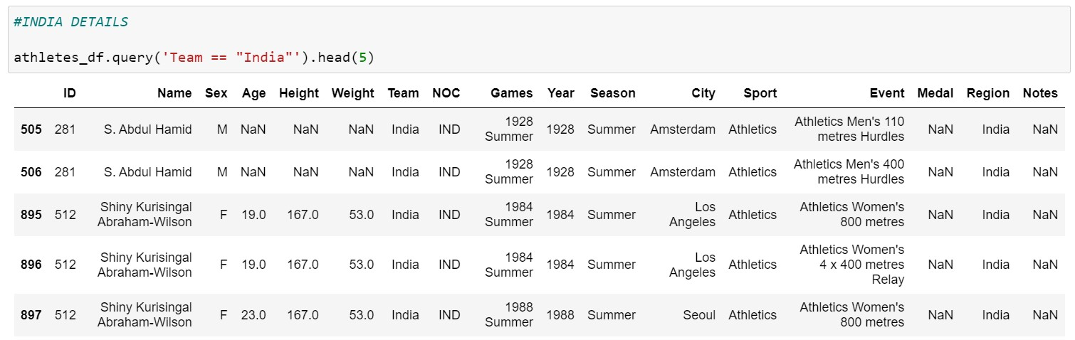
Task 6 : Printing details of team of Countries india and japan

Slide 27
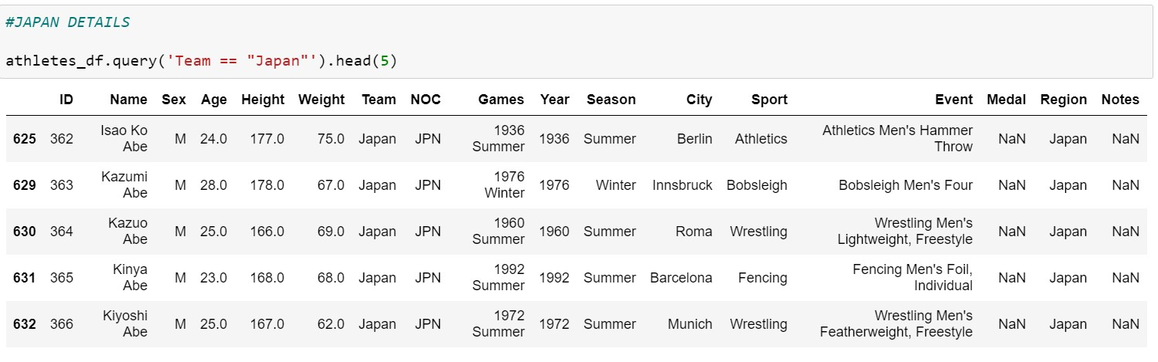
Task 6 cont.

Slide 28
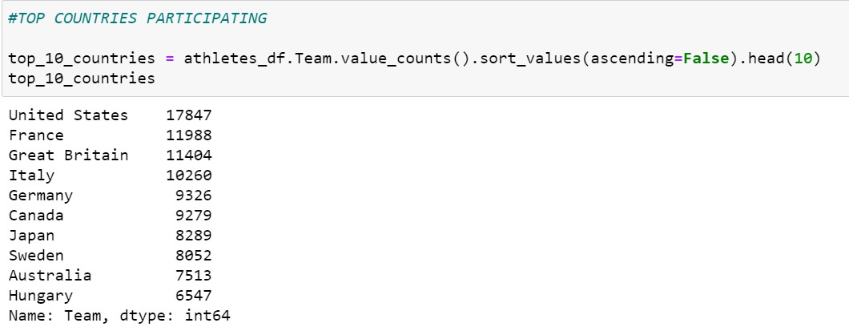
Task 7 : Printing top 10 countries participating

Slide 29
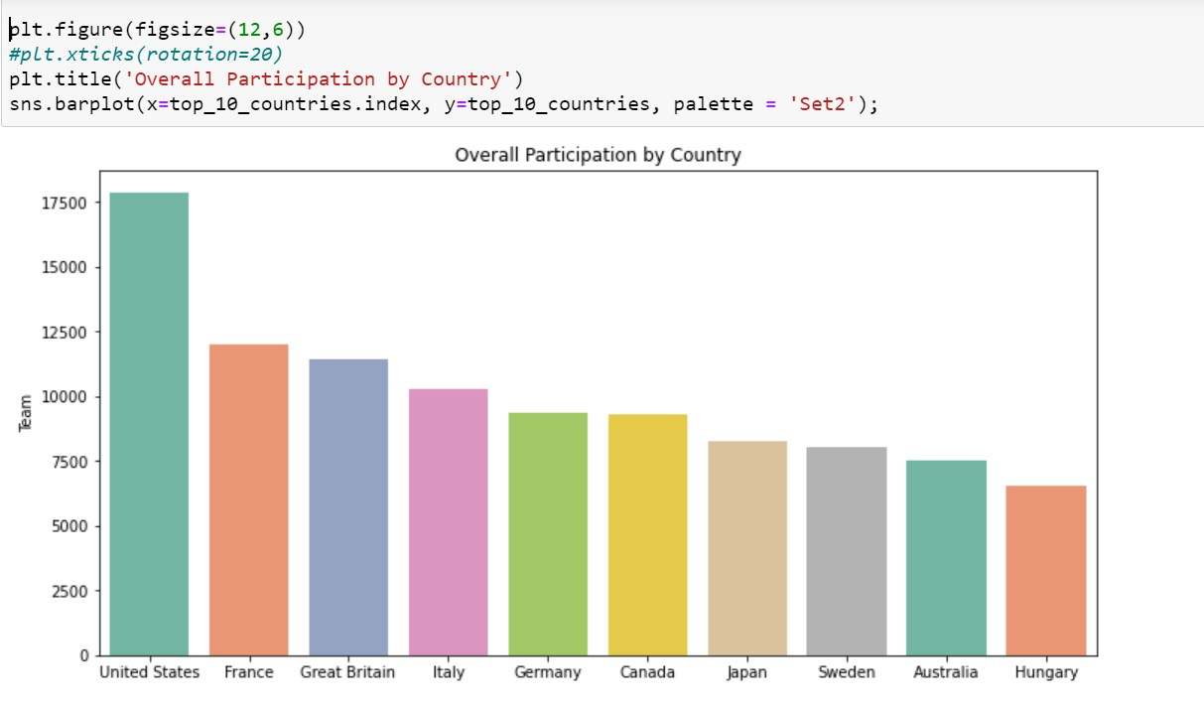
Task 8 : Plotting a bar graph for top 10 countries participating

Slide 30
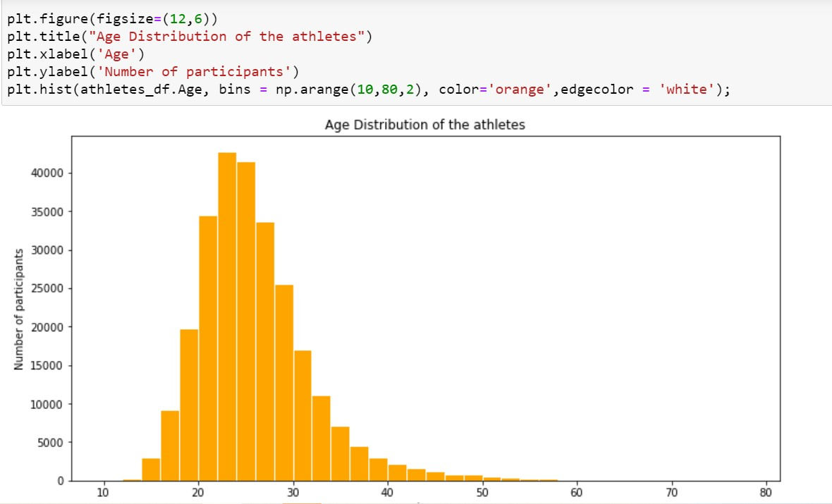
Task 9 : PLOT a histogram for age distribution of participants

Slide 31
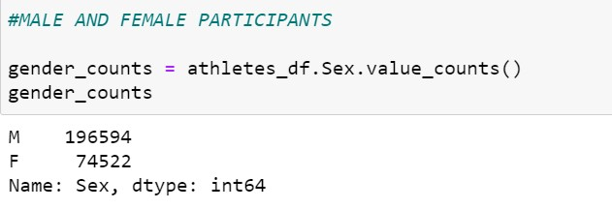
Task 10 : Pie plot for male and female participants

Slide 32
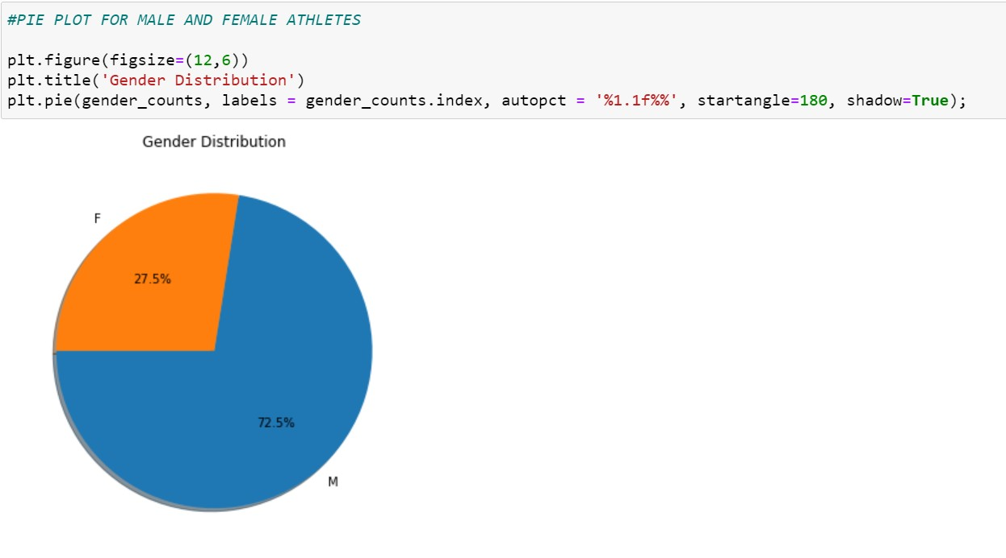
Task 10 cont.

Slide 33
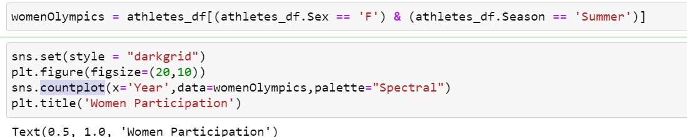
Task 11 : Plot a countplot for women participation

Slide 34
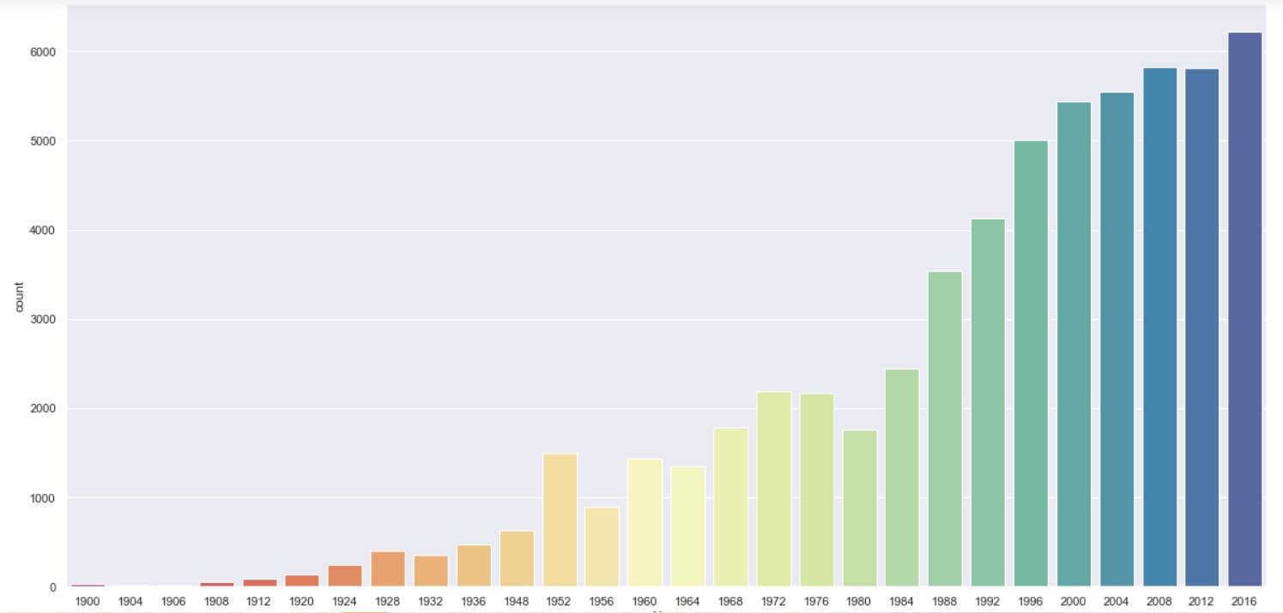
Task 11 cont.

Slide 35
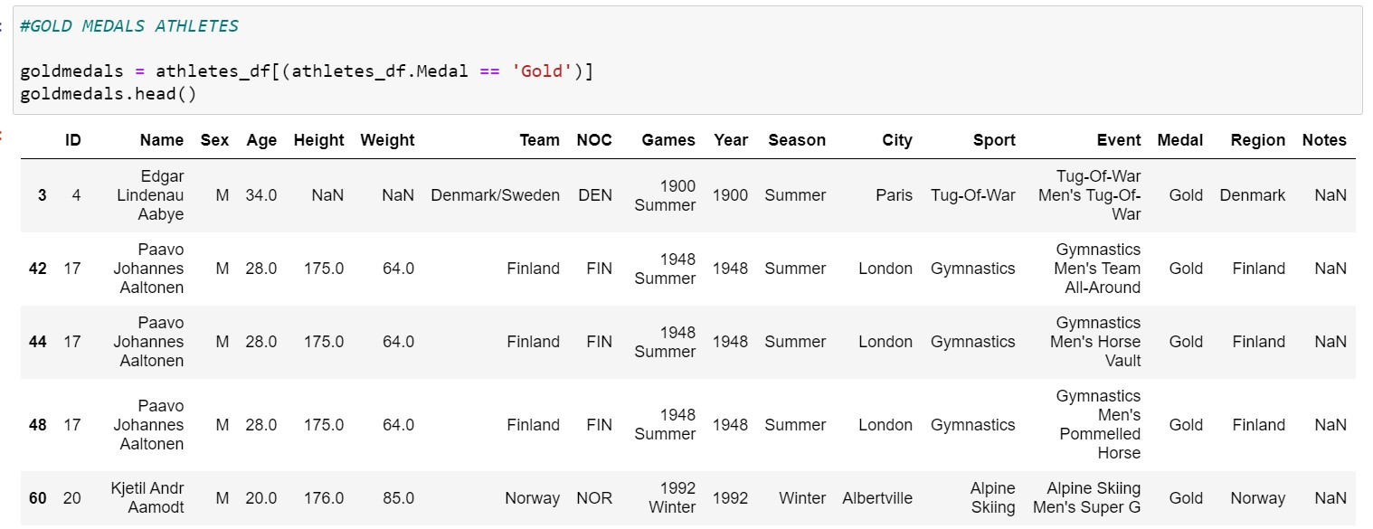
Task 12 : Print the athletes with gold medal

Slide 36
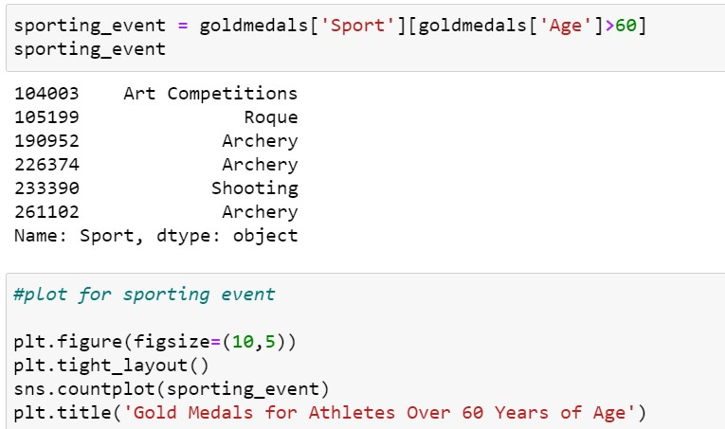
Task 13 : Plot for gold medal athletes above 60

Slide 37
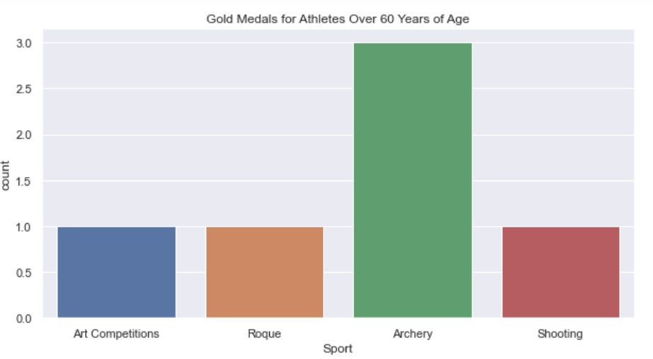
Task 13 cont.

Slide 38
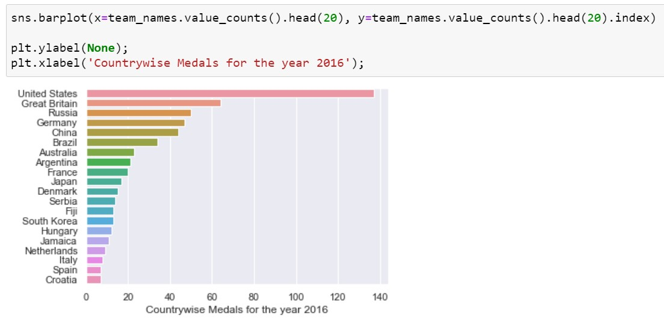
Task 14: Barplot for countrywise medal in 2016

Slide 39


